Slide 1


KONGU ENGINEERING COLLEGE
PERUNDURAI ERODE-638060
DEPARTMENT OF CT-UG
ACADEMIC PROJECT
TITLE : Autoweave Enterprise Resource Management System
PROJECT DOMAIN : CONSULATANCY
PROJECT GUIDE : M.HEMALATHA
TEAM NUMBER : 02
TEAM MEMBERS : ENIGA.P(23BCR015)
GOPIKA.S(23BCR017)
SAMEEKA.N(23BCR046)

Slide 2
ABSTRACT
The system replaces manual registers by digitally managing raw materials, cloth meterage, financial transactions, and daily production records, reducing errors and delays.
It accurately calculates usable cloth meters from customer-provided yarn or fabric, ensuring proper tracking, fair exchange, and prevention of material mismanagement.
Maintains complete employee profiles including attendance, assigned work, productivity, and automated salary calculation based on output, work type, or monthly basis.
Provides interactive dashboards with daily, weekly, and monthly reports on production, employee performance, raw material usage, and salary expenses to support informed decision-making.

Slide 3
PROBLEM DEFINITION
Inefficient Production Tracking: Relying on manual entries for daily meter production leads to data entry errors, lack of real-time efficiency monitoring, and difficulty in calculating remaining production targets for specific orders.
Fragmented Worker Management: Tracking worker attendance and shifts on paper makes transparency difficult. Manual calculation of salaries based on varying shift rates is time-consuming and prone to mathematical errors.
Lack of Integrated Financials: Payment processing (salaries) is often disconnected from attendance records, leading to delays in payouts and difficulties in maintaining payment history.
No Data-Driven Decisions: The absence of a consolidated dashboard means owners cannot easily see a bird's-eye view of their mill's health, such as active machines, daily output trends, and overall efficiency.

Slide 4
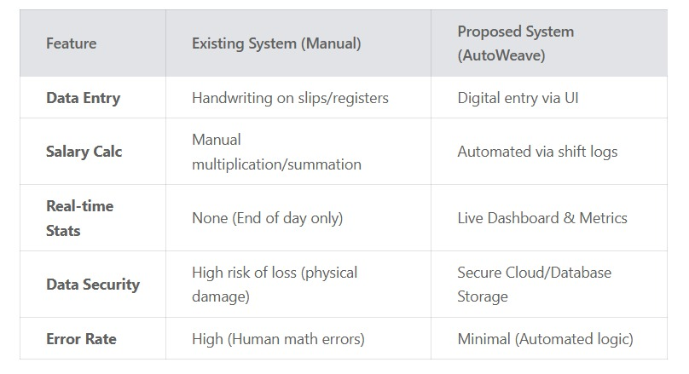
COMPARISON BETWEEN EXISTING SYSTEM AND PROPOSED SYSTEM

Slide 5
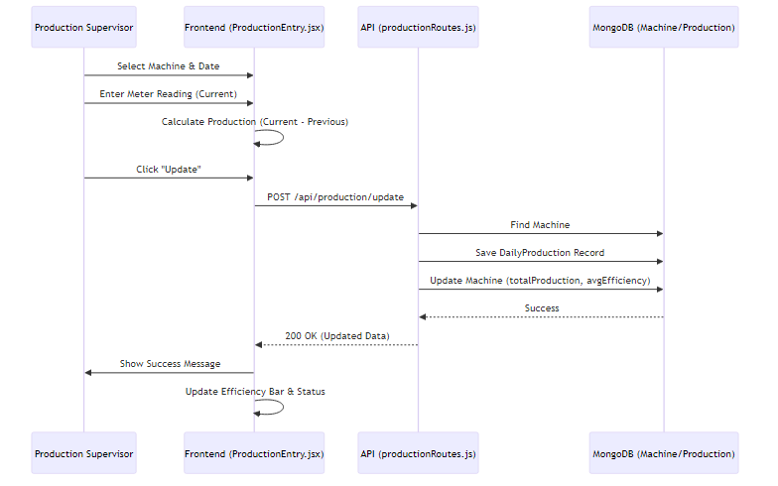
SYSTEM FLOW DIAGRAMS
PRODUCTION TRACKING FLOW

Slide 6
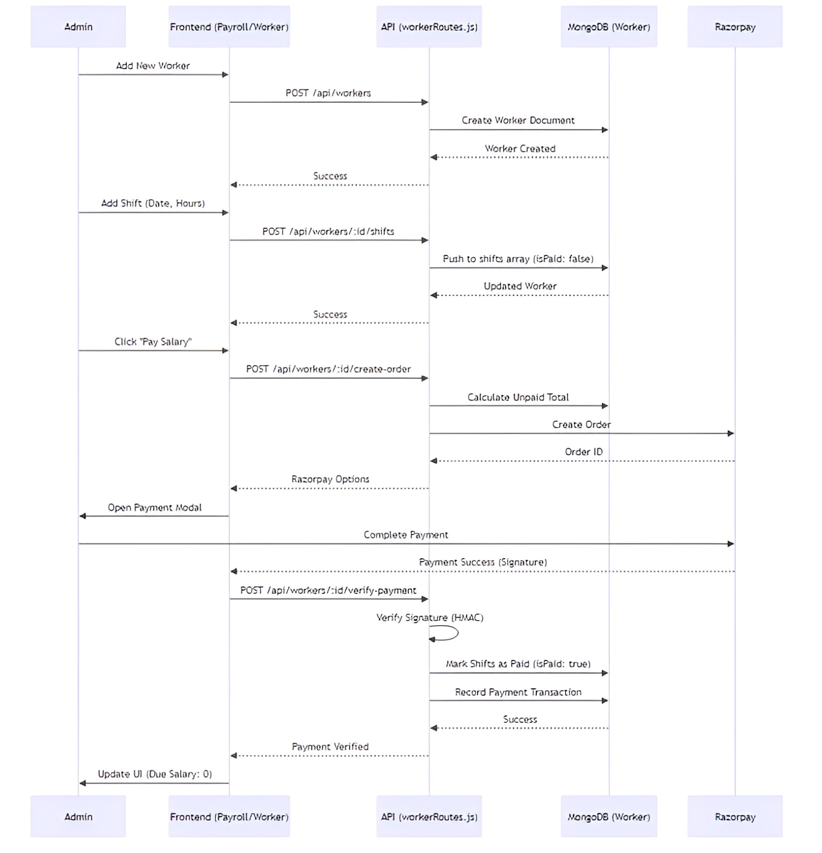
WORKER AND PAYROLE FLOW

Slide 7
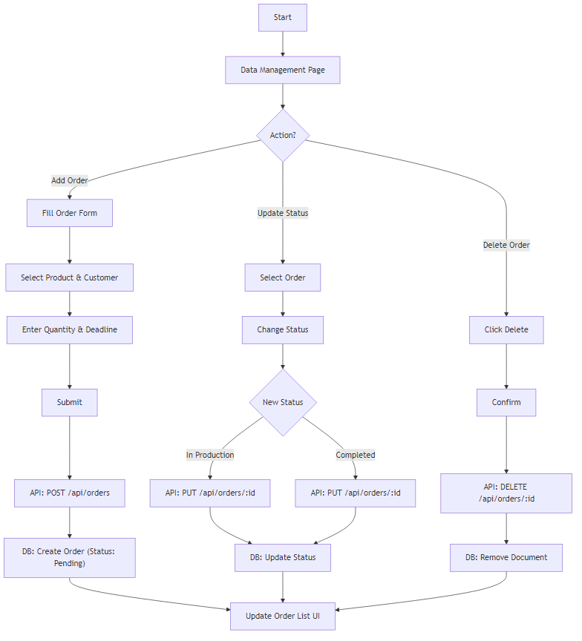
ORDER MANAGEMENT FLOW

Slide 8
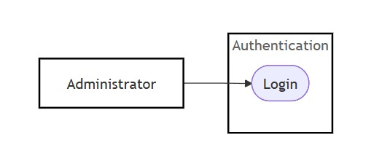
USE CASE DIAGRAM
AUTHENTICATION MODULE

Slide 9
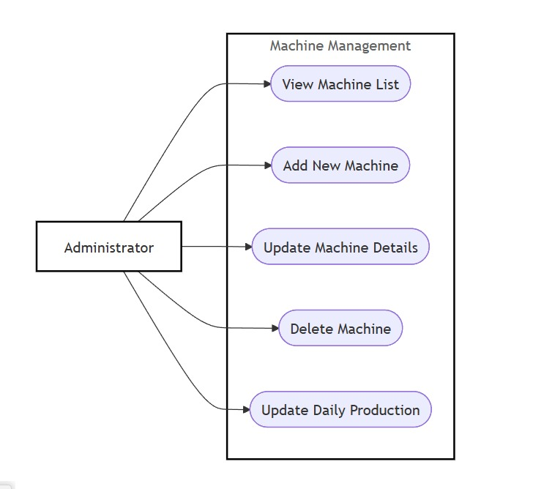
MACHINE MANAGEMENT MODULE

Slide 10
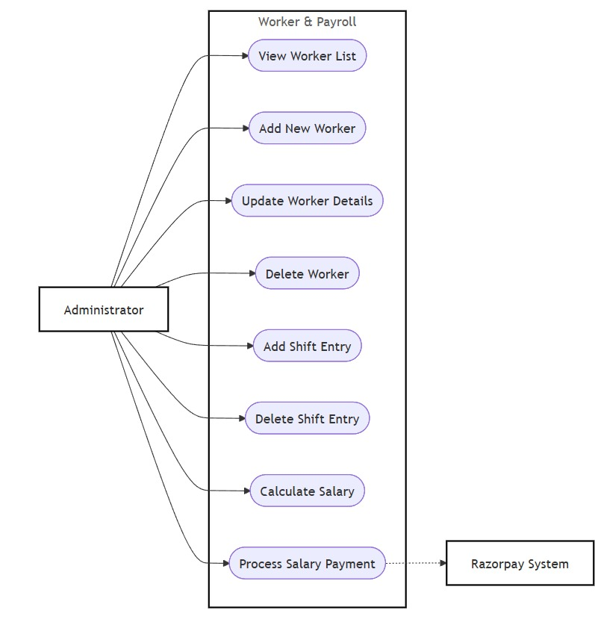
WORKER AND PAYROLL MANAGEMENT MODULE

Slide 11
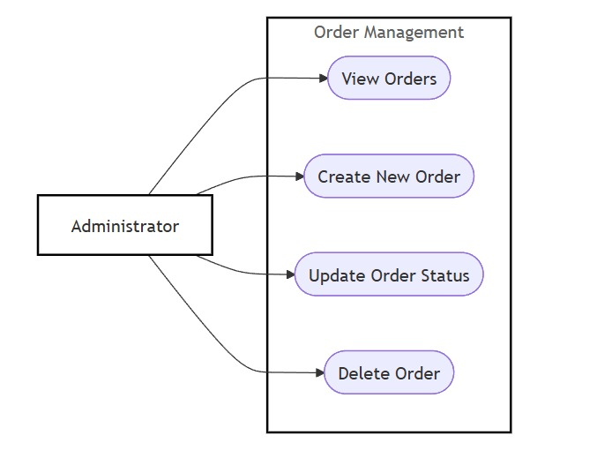
ORDER MANAGEMENT MODULE

Slide 12
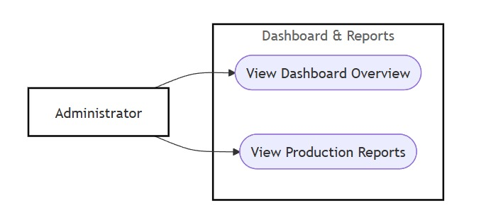
DASHBOARD AND REPORTS MODULE

Slide 13
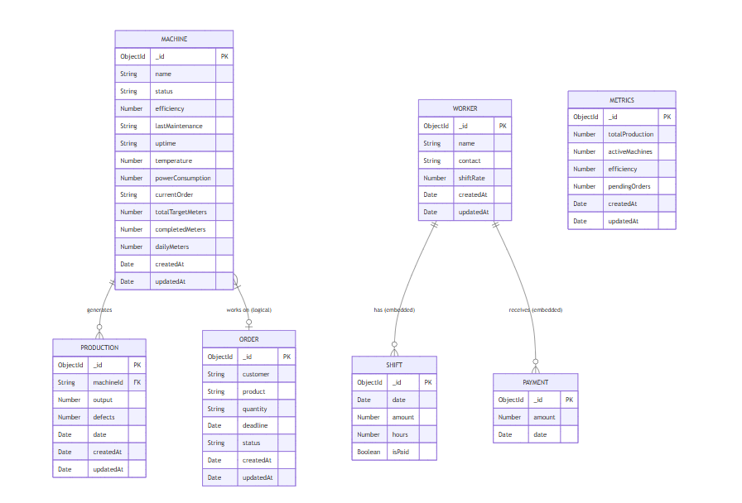
ER DIAGRAM

Slide 14
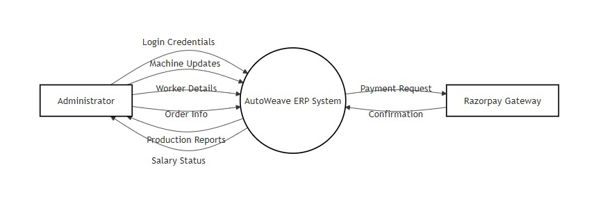
DATA FLOW DIAGRAM LEVEL 0

Slide 15
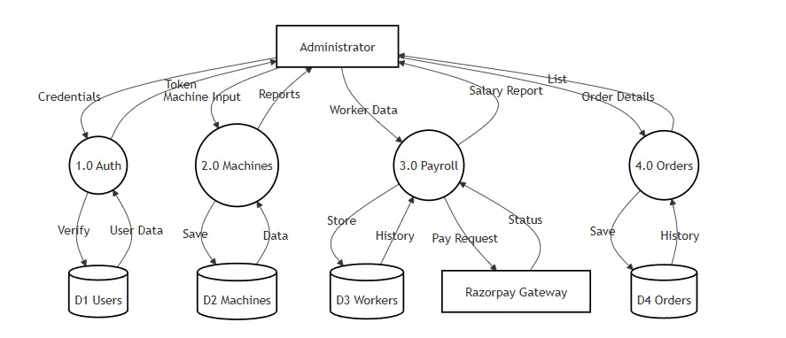
DATA FLOW DIAGRAM LEVEL 1

Slide 16
MODULE SPECIFICATION
AUTHENTICATION MODULE:
Authentication Module-Purpose: To ensure secure access to the system and protect sensitive production and payroll data.
Key Features: Secure Login/Logout functionality.
Data Entities: User (Email, Password).
MACHINE MANAGEMENT MODULE:
Purpose: To track the status, efficiency, and production output of every loom in the factory.
Key Features: Inventory Tracking: Add, edit, and remove machines.
Production Logging: Record daily meter counts.
Automated Calculations: Dynamic calculation of "Remaining Meters" based on target orders.
Status Monitoring: Real-time status indicators (Running, Stopped, Maintenance, Faulty).
Data Entities: Machine (Name, Status, Daily Meters, Completed Meters, Target Meters).

Slide 17
WORKER AND PAYROLL MODULE:
Purpose: To manage the workforce and automate salary distribution.
Key Features: Maintain profiles with contact info and base shift rates.
Shift Management: Record daily attendance/shifts.
Payroll Processing: Automated calculation of due salary (Unpaid Shifts × Shift Rate).
Payment Integration: Digital payout via Razorpay and manual cash entry recording.
Shift Corrections: Ability to delete or edit erroneous shift entries.
Data Entities: Worker, Shift, Payment.
ORDER MANAGEMENT MODULE:
Purpose: To manage customer demands and ensure production alignment with deadlines.
Key Features: Customer Records: Store customer names and specific product requirements.
Quantity Tracking: Track orders in meters or relevant textile units.
Status Workflow: Track order lifecycle (Pending → In Production → Completed).
Deadline Monitoring: Alert administrators of upcoming delivery dates.
Data Entities: Order (Customer, Product, Quantity, Deadline, Status).

Slide 18
DASHBOARD AND REPORTS MODULE:
Purpose: To provide a high-level visual summary of the entire manufacturing operation.
Key Features: Metrics Overview: Display total production, active machines, and overall mill efficiency.
Visual Data: Charts for shift distributions and production trends.
Status Snapshots: Quick-view counters for pending orders and worker stats.
Data Entities: Metrics, Aggregate data from Machine and Worker collections.

Slide 19
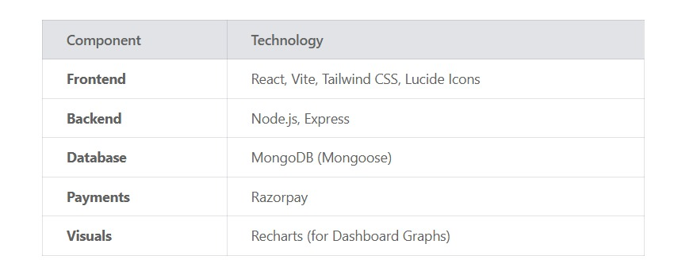
TECHNOLOGIES USED

Slide 20


Thank You !!

